Slide 1

Lecture 4:
Logical Effort

Slide 2

Introduction
Chip designers face a bewildering array of choices
  What is the best circuit topology for a function?
  How many stages of logic give least delay?
  How wide should the transistors be?
Logical effort is a method to make these decisions
  Uses a simple model of delay
  Allows back-of-the-envelope calculations
  Helps make rapid comparisons between alternatives
  Emphasizes remarkable symmetries

Slide 3
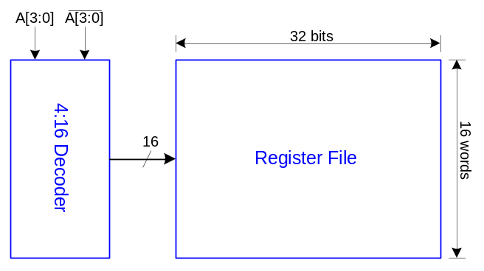
Example
Ben Bitdiddle is the memory designer for the Motoroil 68W86, an embedded automotive processor. Help Ben design the decoder for a register file.
Decoder specifications:
  16 word register file
  Each word is 32 bits wide
  Each bit presents load of 3 unit-sized transistors
  True and complementary address inputs A[3:0]
  Each input may drive 10 unit-sized transistors
Ben needs to decide:
  How many stages to use?
  How large should each gate be?
  How fast can decoder operate?

Slide 4
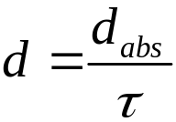
Delay in a Logic Gate
Express delays in process-independent unit
Delay has two components: d = f + p
f: effort delay = gh (a.k.a. stage effort)
  Again has two components
g: logical effort
  Measures relative ability of gate to deliver current
  g ≡ 1 for inverter
h: electrical effort = C_{out} / C_{in}
  Ratio of output to input capacitance
  Sometimes called fanout
p: parasitic delay
  Represents delay of gate driving no load
  Set by internal parasitic capacitance
τ =3RC
≈ 3 ps in 65 nm process
60 ps in 0.6 μm process

Slide 5
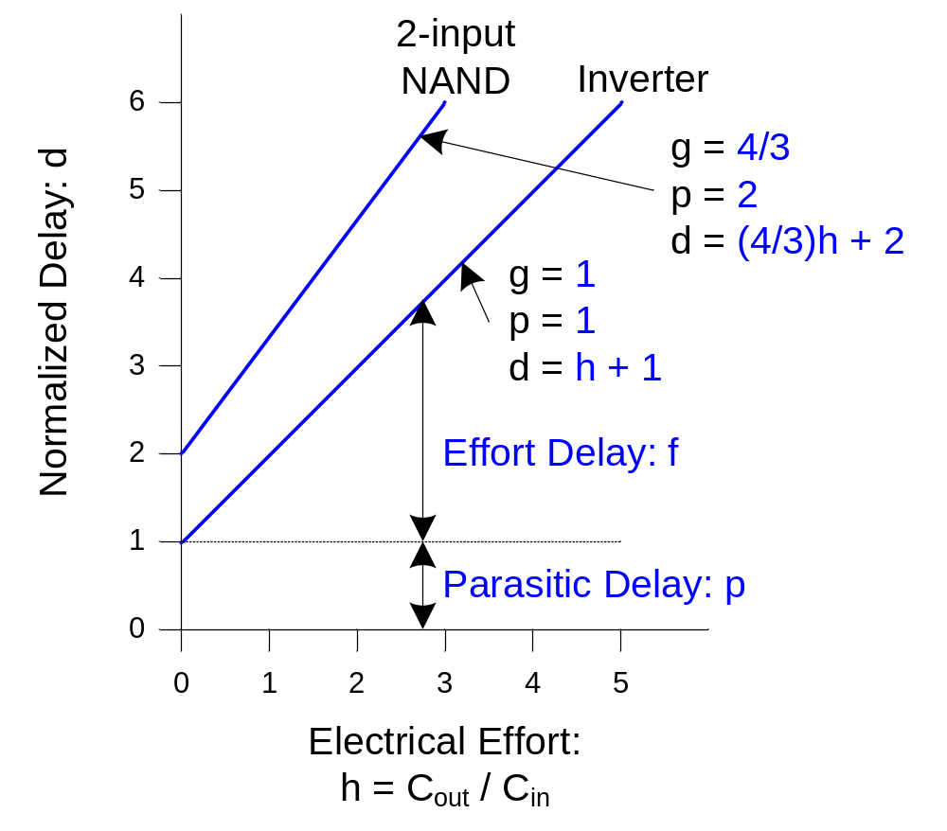
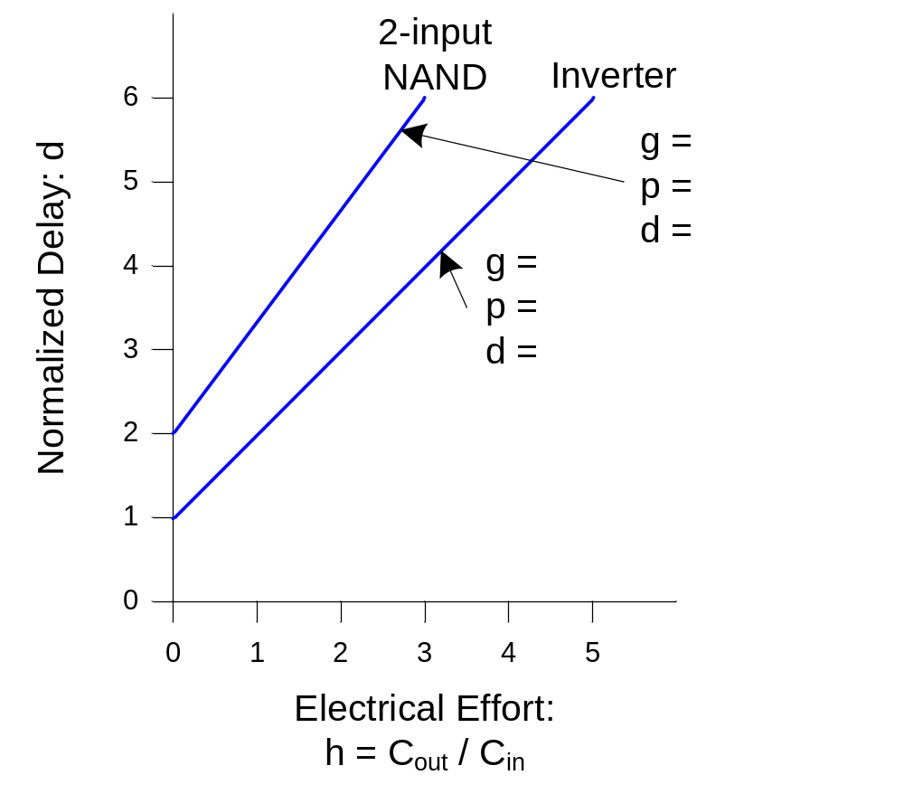
Delay Plots
d = f + p
  = gh + p
What about
NOR2?

Slide 6
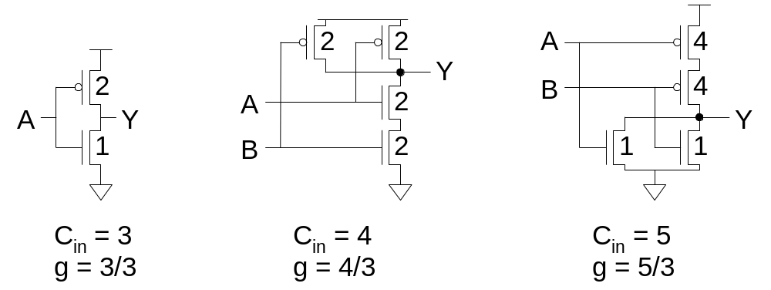
Computing Logical Effort
DEF: Logical effort is the ratio of the input capacitance of a gate to the input capacitance of an inverter delivering the same output current.
Measure from delay vs. fanout plots
Or estimate by counting transistor widths

Slide 7
Catalog of Gates
Logical effort of common gates
Gate type | Number of inputs
 | 1 | 2 | 3 | 4 | n
Inverter | 1
NAND |  | 4/3 | 5/3 | 6/3 | (n+2)/3
NOR |  | 5/3 | 7/3 | 9/3 | (2n+1)/3
Tristate / mux | 2 | 2 | 2 | 2 | 2
XOR, XNOR |  | 4, 4 | 6, 12, 6 | 8, 16, 16, 8
6: Logical Effort

Slide 8
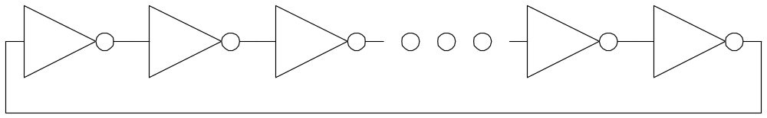
Example: Ring Oscillator
Estimate the frequency of an N-stage ring oscillator
Logical Effort: g = 1
Electrical Effort: h = 1
Parasitic Delay: p = 1
Stage Delay: d = 2
Frequency: f_{osc} = 1/(2*N*d) = 1/4N
31 stage ring oscillator in 0.6 μm process has frequency of ~ 200 MHz

Slide 9
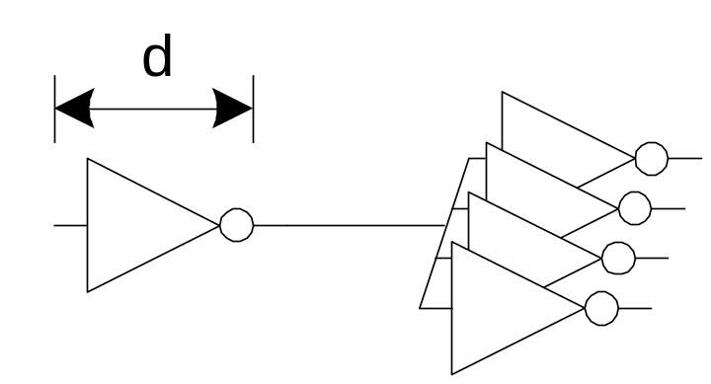
Example: FO4 Inverter
Estimate the delay of a fanout-of-4 (FO4) inverter
Logical Effort: g = 1
Electrical Effort: h = 4
Parasitic Delay: p = 1
Stage Delay: d = 5
The FO4 delay is about
300 ps in 0.6 μm process
15 ps in a 65 nm process

Slide 10
Limits of Logical Effort
Chicken and egg problem
  Need path to compute G
  But don’t know number of stages without G
Simplistic delay model
  Neglects input rise time effects
Interconnect
  Iteration required in designs with wire
Maximum speed only
  Not minimum area/power for constrained delay

Slide 11
Summary
Logical effort is useful for thinking of delay in circuits
  Numeric logical effort characterizes gates
  NANDs are faster than NORs in CMOS
  Paths are fastest when effort delays are ~4
  Path delay is weakly sensitive to stages, sizes
  But using fewer stages doesn’t mean faster paths
  Delay of path is about log₄F FO4 inverter delays
  Inverters and NAND2 best for driving large caps
Provides language for discussing fast circuits
  But requires practice to master

